Slide 1



Succeeding with automatic enrolment:
Expert insights for advisers
Reference slides
March 2024

Slide 2


Agenda
2.35 Resolving common errors, Andy Nicholls
2.45 Navigating compliance, Joe Turner
2.50 Directors and AE, Andy Nicholls
2.55 Upcoming pension reforms, Joe Turner
3.05 Panel Q&A, All
3.30 Closing remarks, Lisa Morrell
Andy Nicholls
Payroll Industry Liaison Manager
Joe Turner
Head of Compliance and Enforcement

Slide 3

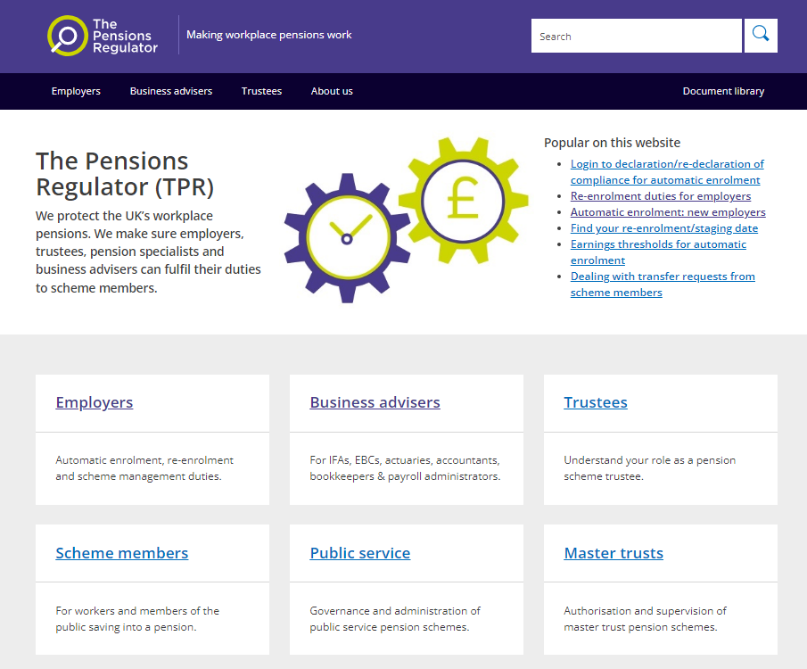





Key to icons
Information
Detailed guidance
This is where you will find our detailed guidance
Guidance
Download
Link

Slide 4

Common errors
As advisers, your support to employers is vital. As well as helping employers avoid mistakes you may also be able to help them resolve any errors they do have. Some of the common errors we find when investigating compliance are:
using the wrong pension contribution tax relief method
not correctly identifying elements of gross pay as qualifying earnings and as pensionable pay
employer contributions during statutory leave and the use of postponement
View the guide for business advisers on our website:
Automatic enrolment guide for business advisers
The guide includes a range of resources for advisers to help you support your clients with their automatic enrolment duties:
Supporting resources

Slide 5

Common errors
What to do when the wrong tax relief method is used
There are two types of tax relief used for employee pension contributions. They are Net Pay Arrangement and Relief at Source, often referred to as RAS.
Only one tax relief method can be in use per pension scheme, so it is very important the right method is being used.
Group personal pension schemes will always use RAS. Master trusts usually have a single method for all their pension schemes. For instance, NEST is always RAS.
Smart and Now Pensions are always Net Pay Arrangement. Some may give the employer a choice, such as The People’s Pension, which defaults to RAS but allows the employer to choose Net Pay Arrangement method.
For information about tax
relief methods, view the guidance for business advisers on our website:
What to consider when
choosing a pension scheme

Slide 6
Common errors
What to do when the wrong tax relief method is used continued…
Please check that your clients are using the correct method. If you find any that are not, you should speak with your client and their pension provider and establish steps to rectify the situation, such as:
correcting the error going forward
working out how far back the problem goes
working out who is affected and what the amounts are
and a timescale for correcting the problem
Most importantly - communicate with affected employees. You may also need to include HMRC in your discussions, especially where net pay arrangement has been used instead of RAS or multiple tax years are involved.
For information about tax
relief methods, view the guidance for business advisers on our website:
What to consider when
choosing a pension scheme

Slide 7



Common errors
What to do when the wrong tax relief method is used continued…
The employer should also notify TPR of the error so we are aware and can offer help if needed.
Please do not delay in checking your clients’ payrolls and pension scheme requirements. Where net pay arrangement has been used instead of RAS.
Where net pay arrangement has been used instead of RAS the employee will have received too much tax relief and so is very likely to have underpaid tax. HMRC will look to the employer to fix this and possibly repay any underpayment.
Where RAS has been used instead of net pay arrangement there will be an underpayment of employee pension contributions which the employee will need to pay although we would expect the employer to make up any shortfall. It is very important that any errors are identified and fixed as soon as possible as the work and cost involved can be very significant if not found early.
Ensure you notify TPR of the error
The employer must notify TPR of the error, visit our website:
How to notify us
For information about tax
relief methods, view the guidance for business advisers on our website:
What to consider when
choosing a pension scheme

Slide 8

Common errors
Pay elements not correctly defined as being qualifying earnings and/or pensionable
Another error we see is where the pay elements have not been correctly identified as being qualifying earnings, pensionable, or both.
Qualifying earnings are defined as:
salary
wages
bonus
overtime
commission
statutory payments
and any item of pay that would fall into these categories
View the guide for business advisers on our website:
Automatic enrolment guide for business advisers
The guide includes a range of resources for advisers to help you support your clients with their automatic enrolment duties:
Supporting resources

Slide 9
Common errors
Pay elements not correctly defined as being qualifying earnings and/or pensionable continued…
using the wrong pension contribution tax relief method
not correctly identifying elements of gross pay as qualifying earnings and as pensionable pay
employer contributions during statutory leave and the use of postponement
The employer needs to review all their elements of pay that make up gross and determine which ones are qualifying earnings and which ones are pensionable. Some will be both. In conjunction with your client, please ensure that all the pay elements have been correctly classified.
If you find an error then, as before, please speak with your client and the pension provider and establish the steps to rectify the problem, such as:
correcting the error going forward
working out how far back the problem goes
working out who is affected
and what the amounts are
It is really important to communicate with affected staff.

Slide 10
Common errors
Pay elements not correctly defined as being qualifying earnings and/or pensionable continued…
Where some pay elements have not been correctly identified as pensionable the employer, with your help needs to look back over payroll records and calculate any underpayment of contributions and arrange to pay the amounts over to the pension scheme as soon as reasonably possible.
Where the employee owes contributions, we would look to the employer to pay these. Or, as a minimum, the employer should enable the arrears to be paid in instalments.
Where some pay elements have not been correctly identified as qualifying earnings the employer with your help needs to look back over the payroll records and re-assess any worker to see if they should have been enrolled, or if already enrolled, then enrolled from an earlier date.
Where they should have been enrolled or enrolled earlier contributions will be due from this date onwards. The employer will need to pay over all the missing employer contributions, and we would expect the employer to also pay over the missing employee contributions. Or, as a minimum, the employer should enable the arrears to be paid in instalments. Please remember the assessment at re-enrolment could also be impacted.
These newly enrolled staff members will need to receive an enrolment letter and will have the right to opt out.

Slide 11
Common errors
Statutory leave and employer contributions
This is a recap from last year’s webinar as we are still finding errors in employer contribution rates for employees during statutory leave.
Visit the
MoneyHelper website
for more information:
Maternity and paternity leave and your pension
Maternity leave
The correct calculation of employee and employer contributions
during maternity leave.
In simple terms:
  The employee pays contributions on actual pay received.
  The employer pays contributions based on the pay the individual would be receiving if they were not on maternity leave.
  Contributions are normally due for the paid maternity period. Employers may need support in calculating contributions for employees on statutory leave.
Disclaimer
The requirement for the employer to pay pension contributions on a worker’s salary that would have been payable if they were not on maternity leave is in legislation that we do not have responsibility under and do not regulate, and so we’ve taken the time to research the requirement to be able to give you a view. You should note, however, that this is all we are able to do, express a view. Only the courts can give a definite interpretation of the law and in this case if an individual was of the view that their employer was not complying with the legislation their recourse would be the Employment Tribunal.

Slide 12


Postponement
Postponement is where the employer can choose to delay the assessment process at their duties start date, for new starters or for those who meet eligible job holder criteria:
Postponement can last from one day up to three months.
At the end of postponement, the member of staff has to be assessed.
If the person meets the eligible job holder criteria at the end of postponement, they must be enrolled.
If the person does not meet the eligible job holder criteria at the end of the current postponement period, then the next time they do meet the eligible job holder criteria the employer can apply postponement again.
But remember if at the end of postponement, the person meets the eligible job holder criteria they must be enrolled and cannot be postponed again.
It is important that you establish with your client the postponement rules they wish to apply and operate them accordingly.
‘Postponement’ does not change or delay the duties start date or declaration of compliance deadline
View the guidance about postponement on our website.
Guidance for business advisers:
Postponement
Guidance for employers:
Postponement – automatic
enrolment guidance for employers

Slide 13
Postponement
The next slide gives a practical example of postponement.
Below is the dialogue that goes with the example on the following slide. The employer pays their staff calendar monthly and has the following postponement rules in place:
all starters are postponed from their start date for the maximum three months
anyone who later meets the eligible job holder criteria is postponed to the start of the following pay reference period

Slide 14
Postponement – a practical example
‘Caroline starts employment on 8 February. She is 25 years old and has a salary of £30,000 per year. The payroll bureau, using the postponement rules set by the employer, postpones Caroline’s assessment until 8 May. The employer or bureau issues a postponement notice within six weeks and 1 day of her start date informing her that the assessment has been postponed until 8 May. The postponement notice will also inform her that she has the right to join the pension scheme at any time and how to do this. 8 May falls into the 1 to 31 May pay reference period so in May’s payroll, Caroline will be assessed based on her age as at 8 May and her qualifying earnings payable in May. Her May qualifying earnings are £750 as she took several weeks of unpaid leave so although she meets the age criteria, her qualifying earnings are too low to meet the eligible job holder criteria, so she is not automatically enrolled.
Caroline returns from unpaid leave in early June. Her qualifying earnings for June are £2,000 so above the monthly threshold of £833. The first day of a pay reference period is always an assessment day. Based on her age as at 1 June and her qualifying earnings for June, she is assessed as an eligible job holder. The employer applies postponement again. This time to the start of the following month, 1 July, and issues another postponement letter accordingly. In July Caroline‘s qualifying earnings are £2,500 and so when assessed at the end of postponement, 1 July, she is an eligible job holder and is therefore automatically enrolled into the scheme. The employer cannot postpone her again. The employer issues a letter informing Caroline she has been automatically enrolled as at 1 July. The letter will also explain about the contribution rates, tax relief method, and the right to opt out. The employer has six weeks to issue the enrolment letter so in this example no later than 11 August.’

Slide 15

Caroline
Started employment 8 Feb 2024, 25 yrs old and has a salary of £30,000 per year, £2,500 per month
Feb
July
June
May
8 Feb
8 May
1 Jun
1 July
Postponement
Postponement
Caroline’s
start date
Assessment date
End of
postponement
Assessment date
Start of pay reference period
Assessment date end of postponement
Enrolled into
pension scheme
Postponed for three month’s applied

Slide 16
Compliance and redeclaration of compliance process
We have noticed some employers are late in submitting their first re-declaration of compliance or the information supplied is not always correct. We have updated our website to make the process easier. On the following slide is a video to demonstrate the process online, though not all the steps are included we hope this will be helpful.

Slide 17
Compliance and redeclaration of compliance process continued…
Firstly, go to our website and access the declaration of compliance page. On this page are the links to the declaration and re-declaration checklists, if you need them. Otherwise, you can login as a guest or sign into your account. If you do not have an account, you can create one here. Enter your email address and password to login and your client dashboard will be displayed listing up to 200 clients.
Clients are listed in declaration date order with nearest at the top. If you have more than 200 clients, no list will appear. However, you can search on the letter code, PAYE reference or employer’s name. You can add a new client from here and utilise the facility to bulk upload multiple declaration and redeclaration of compliances. Select the client you wish to complete the redeclaration for.
The redeclaration duties task list for your client is then displayed showing what steps are still to be completed. In our example we have already completed the pension scheme and PAYE information steps.

Slide 18
Compliance and redeclaration of compliance process continued…
In the About You step, please enter the name and full contact details of the person completing the redeclaration. This is important in case we need to get in touch. Please ensure you enter the re-enrolment date even if you have no one to enrol you must enter the date.
Next you are asked if anyone was re-enrolled, in our example no one was and the final step we show is
Staff details where the number of staff employed, number already in a qualifying scheme and number of ‘other staff’ are entered. If you had said yes to having re-enrolled staff then you will need to also enter the number re-enrolled in the Staff details section. All the numbers need to be accurate. Please ensure you complete all the steps in full and redeclare on time.

Slide 19
Compliance and redeclaration of compliance process continued…
The deadline for completing the first redeclaration of compliance is:
Five months after the third anniversary of the employer’s duties start date with.
Subsequent redeclarations being due five months after the third anniversary of the previous
re-enrolment date.
We recommend that as soon as the payroll which includes the re-enrolment date is completed, the employer, or you on behalf of the employer, completes the re-declaration process.
Where an employer doesn’t redeclare or re-declares late, they are very likely to be fined £400 with further penalties of up to £10,000 per day if it is not resolved. It is therefore very important that the redeclaration is completed on time and accurately.

Slide 20



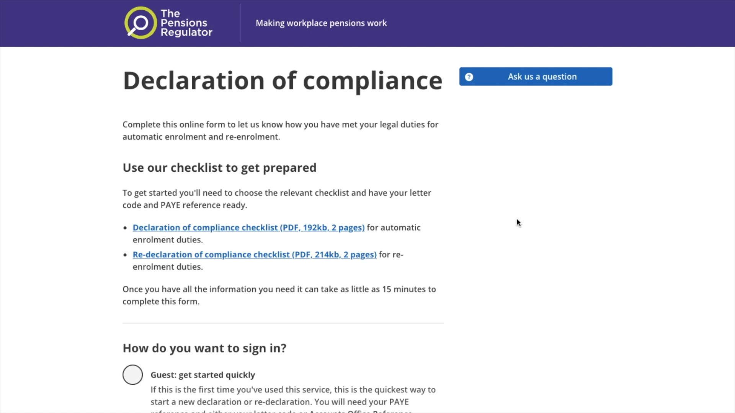
To view this demo video please go to the webinar recording. You can find this by following the ‘Video on Demand’ tab in the left-hand side menu. The recording will be available from Monday 11th March.

Slide 21
Directors
Directors was one of the areas that you wanted us to explain in more detail. We will work through an example shortly but to summarise, the key points are:
if a director is not employed by their company, they are exempt
if a director is employed but no one else is, they are also exempt
if an employed director is not exempt and becomes eligible to
be enrolled or re-enrolled, the employer may choose not to
enrol them
It’s important to understand that the employer’s choice regarding directors applies only to the duty to enrol and re-enrol. All other duties remain unchanged. For instance, they need to be informed that they have the right to join the pension scheme.
View the guidance for
advisers on who is and isn't included:
Check who to automatically enrol in a workplace pension
View the detailed guidance about assessing staff eligibility on our website:
Employer duties and defining the workforce - automatic enrolment
detailed guidance for employers
View the guidance for business advisers about directors on our website:
Director exemptions from automatic enrolment
  *The Channel Isles and the Isle of Man are outside the UK

Slide 22
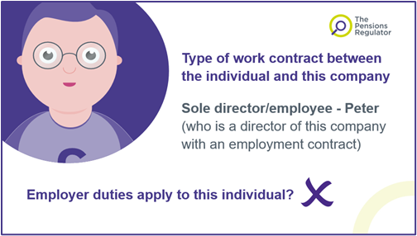
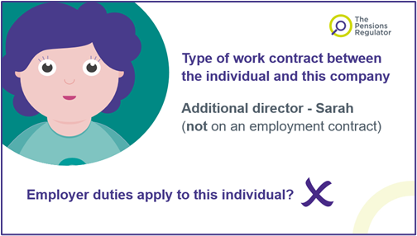
Directors continued…
Let’s look at an example of a director only company
PETER
Peter sets up a company as the sole director and he is employed by his company
No AE duties apply to single director only companies
Business is doing well so he appoints another director, Sarah
SARAH
Sarah is not employed by the company
Although the company is no longer a sole director company, only one of the directors is employed
There are no other employees, so the company is still excluded from AE
Business continues to do well and another director, Vimal is appointed

Slide 23
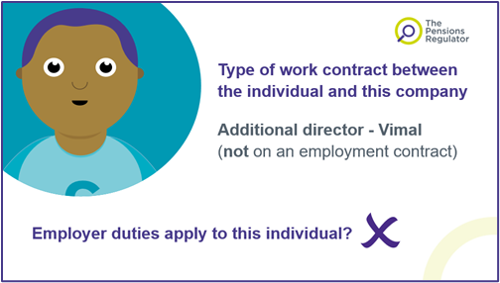
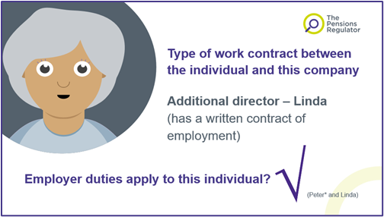
Directors continued…
VIMAL
He too is not employed by the company, and so, the company is still excluded from AE
Business is booming so Peter appoints another director, Linda, who is employed by the company
LINDA
There are now two employed directors and therefore the company now has AE duties
The employed directors now come under AE and need to be informed that they have the right to join the pension scheme
However, the employer can choose whether or not to enrol or re-enrol employed directors
The employer will now have a duties start date
This will be the employment start date of Linda, and the employer will now need to complete a declaration of compliance within five months of this date

Slide 24


(Peter* and Linda)
*As there are two directors with contracts of employment, duties apply to both Peter and Linda. This would be the same even if Linda was not a director and was just an employee - Peter’s exemption would stop when she joined. However, from 6 April 2016, an employer can choose whether or not to automatically enrol/re-enrol any directors who become eligible.

Slide 25


Changing pension schemes
This is an area that requires careful thought and planning. We would expect the following to be considered:
All interested parties and internal departments involved early on
A comprehensive project plan
Due consideration given to the most appropriate effective date for the change and it’s the impact for instance where there is more than one pay frequency
How the scheme closure will work
A full understanding of the new scheme’s rules and requirements
Good and comprehensive communications with all staff especially those enrolled into the current scheme which may include the requirement for a full consultation process to take place if the employer has more than 50 staff
Systems and processes tested and ready for the change
The transfer from one scheme to another would be a contractual change where the new scheme would start on the day following the day that the old scheme ended.
If not a contractual change then an immediate re-enrolment duty would apply where all job holders in the old scheme would need to be automatically enrolled into the new scheme from the day after the old scheme ends
It is very important that the change is carried out correctly and seamlessly.
Ensure you notify TPR of the error
Downloadable
summary of what to consider when choosing
a pension scheme:
How to help your client choose a pension scheme
For information about
what to consider when choosing a pension scheme, view the guidance for business advisers on our website:
What to consider when
choosing a pension scheme

Slide 26
Future changes
Expansion of automatic enrolment
A Private Members’ Bill to help millions save more into their pension and start saving sooner has cleared Parliament and been granted Royal Assent. The Bill introduces powers to reduce the age for being automatically enrolled and enable pension saving from the first pound earned:
with the age at which you can be automatically enrolled or re-enrolled being lowered from 22 to 18, and
the lower earnings threshold being abolished
The Department for Work and Pensions will launch a consultation on implementing the new measures.
Ensure you notify TPR of the error
To view the current version of the Bill, visit the UK Parliament website:
Pensions (Extension of AE) Act 2023
For information about The Private Members’ Bill and its Royal Assent, view the gov.uk website:
Pension saving boost for millions receives Royal Assent

Slide 27
Future changes
Pensions Dashboards
Turning to pensions dashboards, I’m sure you’ve read about this in the trade media, but we wanted to take this opportunity to talk to you about the role you can play:
AE has meant that more people are saving into pensions than ever before and from an early age.
This means most people will end up with more than one or two pots.
We know that keeping track of multiple pots can be tricky, people don’t always let schemes know when they move home, or change name, and this has resulted in a big increase in lost pension pots over the last few years.
For information about the Pensions Dashboard Programme (PDP) visit their website:
Pensions dashboard programme

Slide 28
Future changes
Pensions Dashboards continued…
PPI Lost Pensions Survey 2022 shows the scale of the problem. It showed that over 2.8m pension pots are considered lost, this is an increase of 75% between 2018 to 2022. The average value of a lost pot is not hundreds, but thousands of pounds, an average of £9,470. A significant amount for a saver to be unaware of:
The objective of dashboards is to help people to reconnect with lost pensions and show information in one place and from there they can seek advice and guidance and plan for retirement.
There are around 3,200 pension schemes in scope for dashboards, which between them cover more than 42m savers. As well as workplace pension schemes which are regulated by TPR, the duties also apply to group personal pension schemes regulated by FCA.
To view the Pensions Policy Institute (PPI) lost pensions survey 2018 – 2022 visit PPI website:
Pensions Policy Institute

Slide 29

Future changes
Pensions Dashboards continued…
Savers will register to a dashboard and once their ID is validated (a bit like you do for online banking), their personal information will be shared with schemes, and (where a match is confirmed) relevant value data securely returned.
With schemes expected to connect to dashboards from next year, there is significant work taking place behind the scenes right now, with schemes and those supporting them getting their systems and processes – and importantly their data – ready for their connection.
Data is the lifeblood of a scheme and is fundamentally important to the success of dashboards – so that schemes are matching the right people with the right pensions and returning the right information to dashboards within the expected timescales.
To find out how
you can help prepare your clients data for connection visit our website:
Preparing your data for pensions dashboards

Slide 30
Future changes
Pensions Dashboards continued…
Pensions dashboards have the potential to revolutionise the way that people engage with their pensions. There’s an important role for all employers to play by ensuring they are keeping schemes and providers up to date with changes in personal data.
As you’d expect, name, date of birth, address and National Insurance number are all critical fields for schemes to use to match information provided through a dashboard with data they hold in their scheme. You, as business advisers, can provide support to employers to enable them to play their part – by ensuring that the data that schemes hold is up to date, and accurate.
To find out more about what schemes need to do and how you can help, read our guidance and then talk with your clients about how you are able to support them in providing up to date, accurate staff data to schemes.
For information about pensions dashboards visit our website:
When your scheme needs to connect with dashboards

Slide 31


Future changes
Avoiding scams…
Our final point is a plea for vigilance in preventing your clients and their employees being caught by a scam and losing pension funds.
TPR leads the Pension Scams Action Group which is a multi-agency task force tackling fraud and scams. The task force brings together law enforcement, government and industry, working together to provide valuable intelligence to law enforcement agencies, giving a clear picture of the scale of the problem.
We’re happy to say our Pledge to Combat Scams has over 600 organisations signed up, if you haven’t signed up, please look at the link and make the Pledge to Combat Pension Scams today.
Fraud accounts for 40% of crime in England and Wales and on average only 34 reports of scams are received each month. Our recent campaigns focus on reporting as the best defence, to find out about the warning signs of a scam and how to stop savers being scammed visit the link.
Ensure you notify TPR of the error
To make the pledge to combat pension scams visit our website:
Pledge to combat pension scams
For information about reporting pension scams visit our website:
Avoid and report pension scams

Slide 32
Live Q&A with our panel of experts

Slide 33

Please complete our evaluation

