Slide 1
Emma James
Industry Engagement Specialist
GET DASHBOARDS READY
GET DASHBOARDS READY
GET DASHBOARDS READY
GET DASHBOARDS READY

Slide 2
OVERVIEW
OVERVIEW
OVERVIEW
OVERVIEW
of the legal duties of trustees
and scheme managers

Slide 3


Exploring practical aspects of dashboard preparation
Focusing on data, governance and record-keeping
You Yu
Sally Minchella
Policy Lead for Dashboards
Professional Trustee

Slide 4

Compliance and
enforcement approach
for pensions dashboards
Maria Evgenidou-Wright
Head of Enforcement

Slide 5


Q&A session
Expert panel
Kim Gubler
Joe Stacey
Chair of The Pensions
Administrators Standards
Association (PASA)
The Pensions
Dashboards
Programme (PDP)

Slide 6



Downloadable
slides
Resources from
today’s session will
be available through:
Useful links
document
Webinar
recording

Slide 7
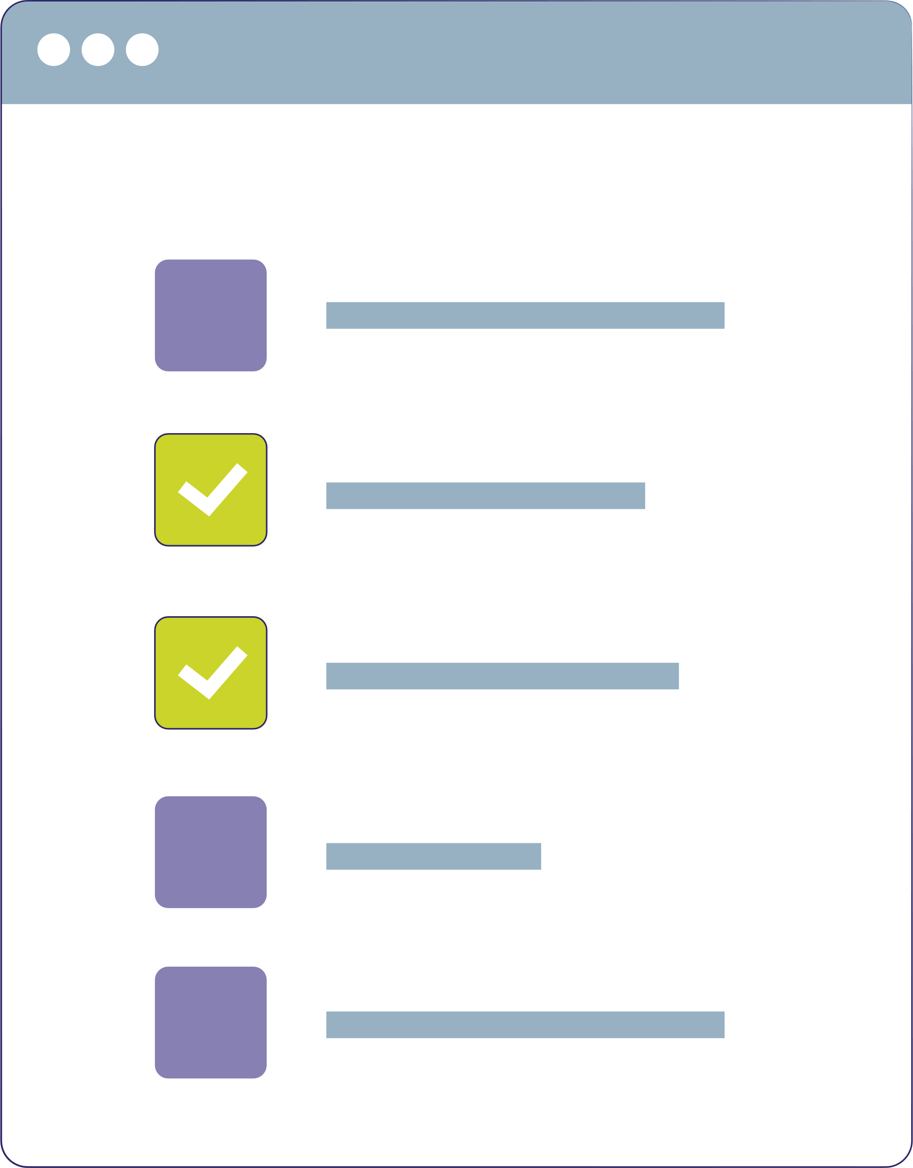



Survey available
at the top of the menu

Slide 8




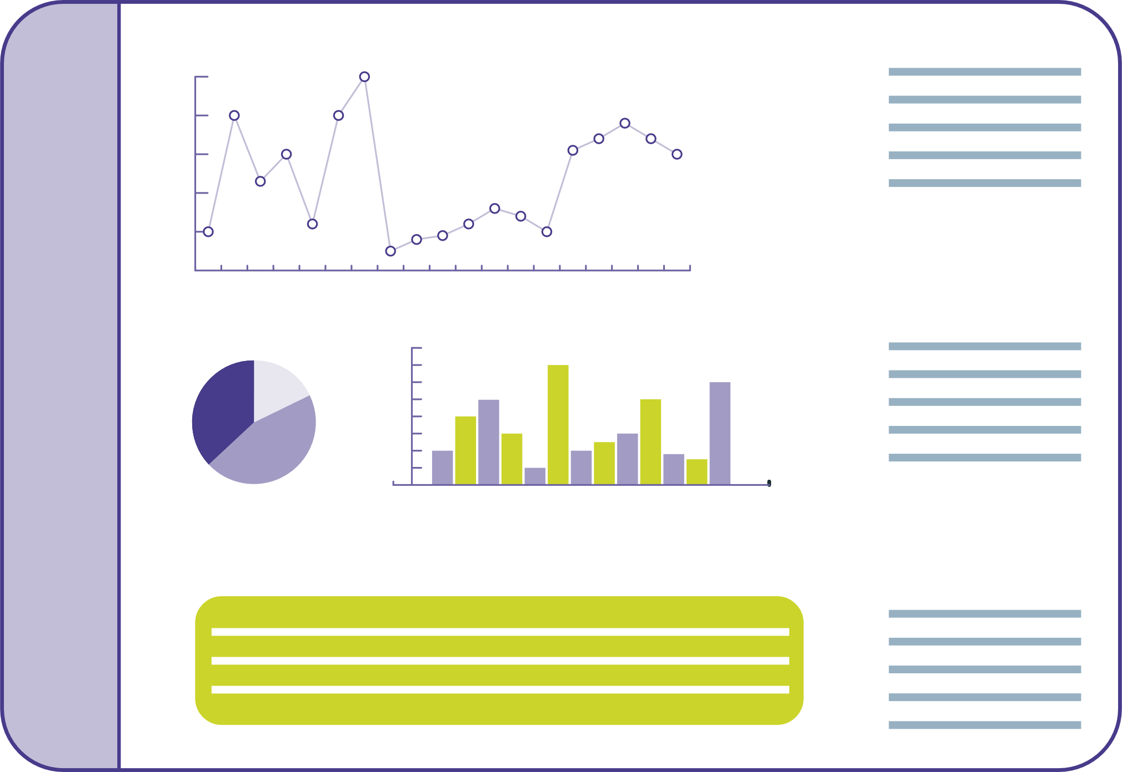
We are committed to the
BENEFITS
that pensions dashboards bring to savers

Slide 9
2,700
occupational trust-based
schemes, covering over
47 MILLION
47 MILLION
47 MILLION

Slide 10


Connected to the
CENTRAL DASHBOARD
ecosystem
Money and Pensions Service – MaPS

Slide 11



The time for the first schemes to start to CONNECT to the ecosystem
is fast approaching

Slide 12




Legislative deadline of
31 October 2026
A staging profile
set in DWP guidance

Slide 13



Enable a controlled
and well-planned onboarding
A staged approach
to connection is
vital to:
Mitigate the risk of capacity concerns
Test systems and processes with a live, yet controlled environment

Slide 14


Important reminder:
Not connecting in line with guidance increases your risk of
non-compliance
Legislative deadline: October 2026

Slide 15


Trustees and
scheme managers
need to consider
the balance of risks

Slide 16
Trustees and Scheme managers need to understand what’s required to meet their
DASHBOARDS DUTIES
DASHBOARDS DUTIES
DASHBOARDS DUTIES
DASHBOARDS DUTIES

Slide 17


We have guidance on our website
and a checklist that you can download

Slide 18


It’s important that schemes work with those supporting them to:
Understand the
impact of the connection dates on their scheme
Develop a practical delivery plan

Slide 19




It’s important to ensure all parts of the scheme are
engaged with the delivery plan

Slide 20


Larger schemes have dashboards firmly on their radar
BUT
Smaller schemes are less prepared
DON’T DELAY!

Slide 21
Success of dashboards will be dependent on the
ACCURACY OF DATA
ACCURACY OF DATA
ACCURACY OF DATA
ACCURACY OF DATA

Slide 22


Finding savers in scheme records
Data that will be required for dashboards:
Returning value data
to savers

Slide 23
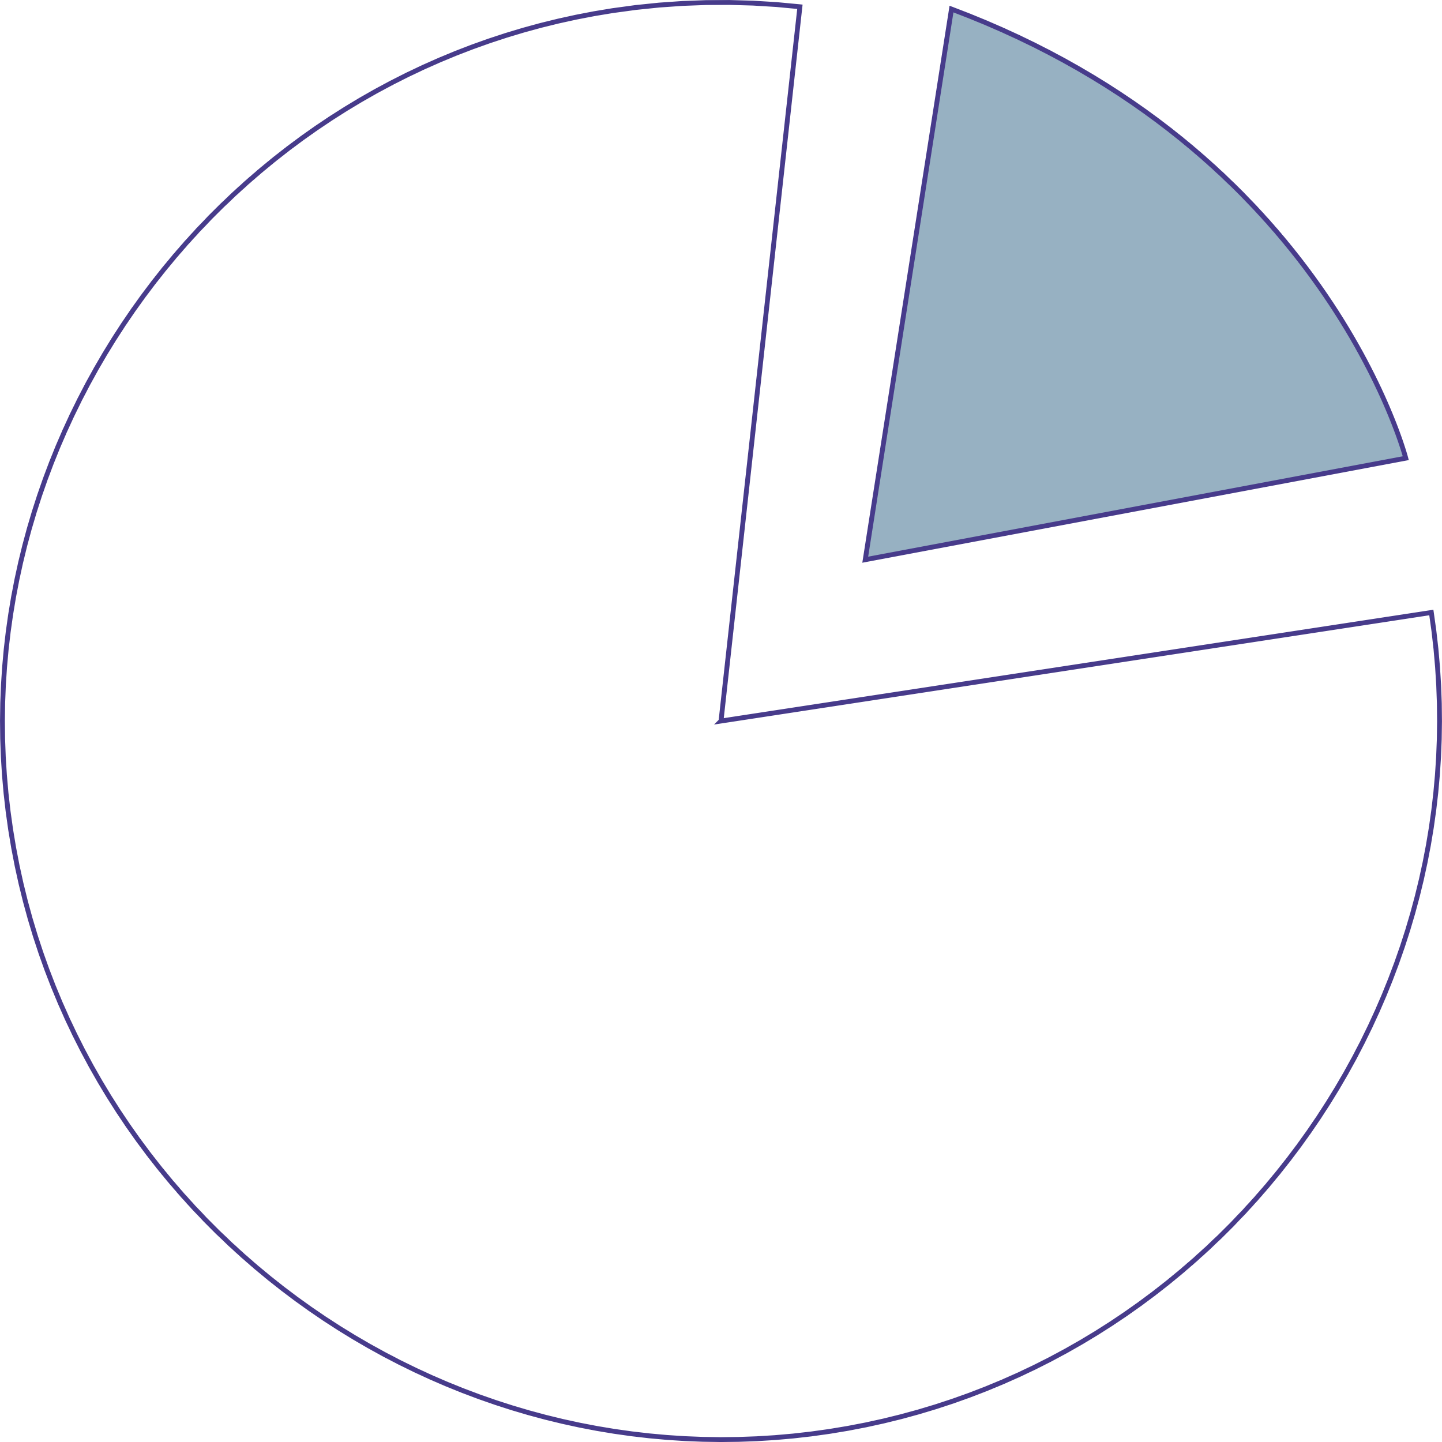


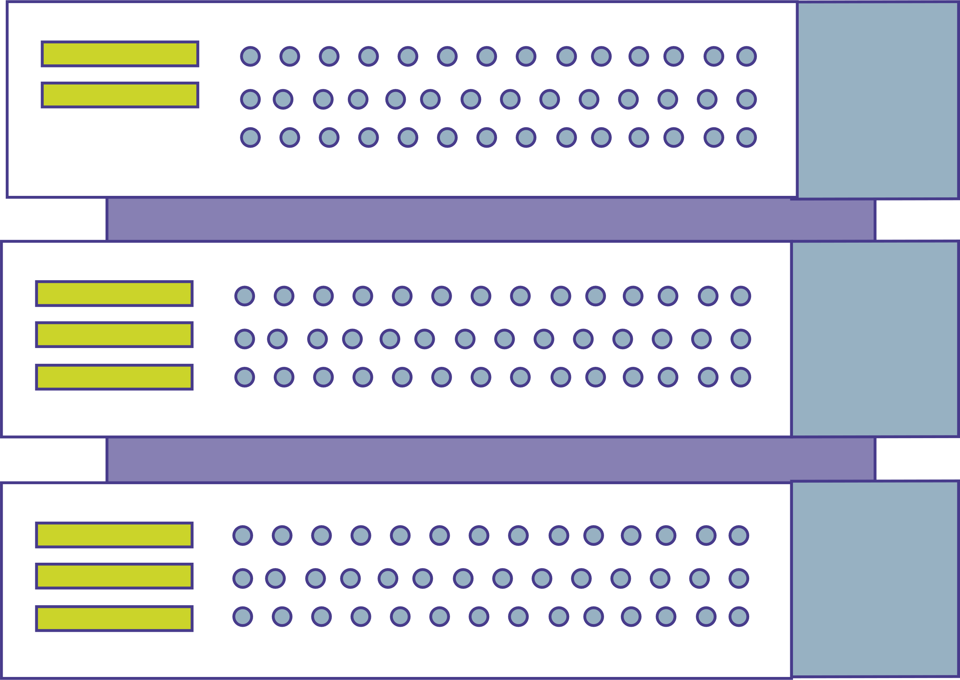
The presence of data does not necessarily reflect the quality of data

Slide 24

TPR set out expectations
over 10 years ago that schemes should measure and improve their data

Slide 25


We are engaging with schemes to ensure standards are met

Slide 26

What to expect from

Slide 27
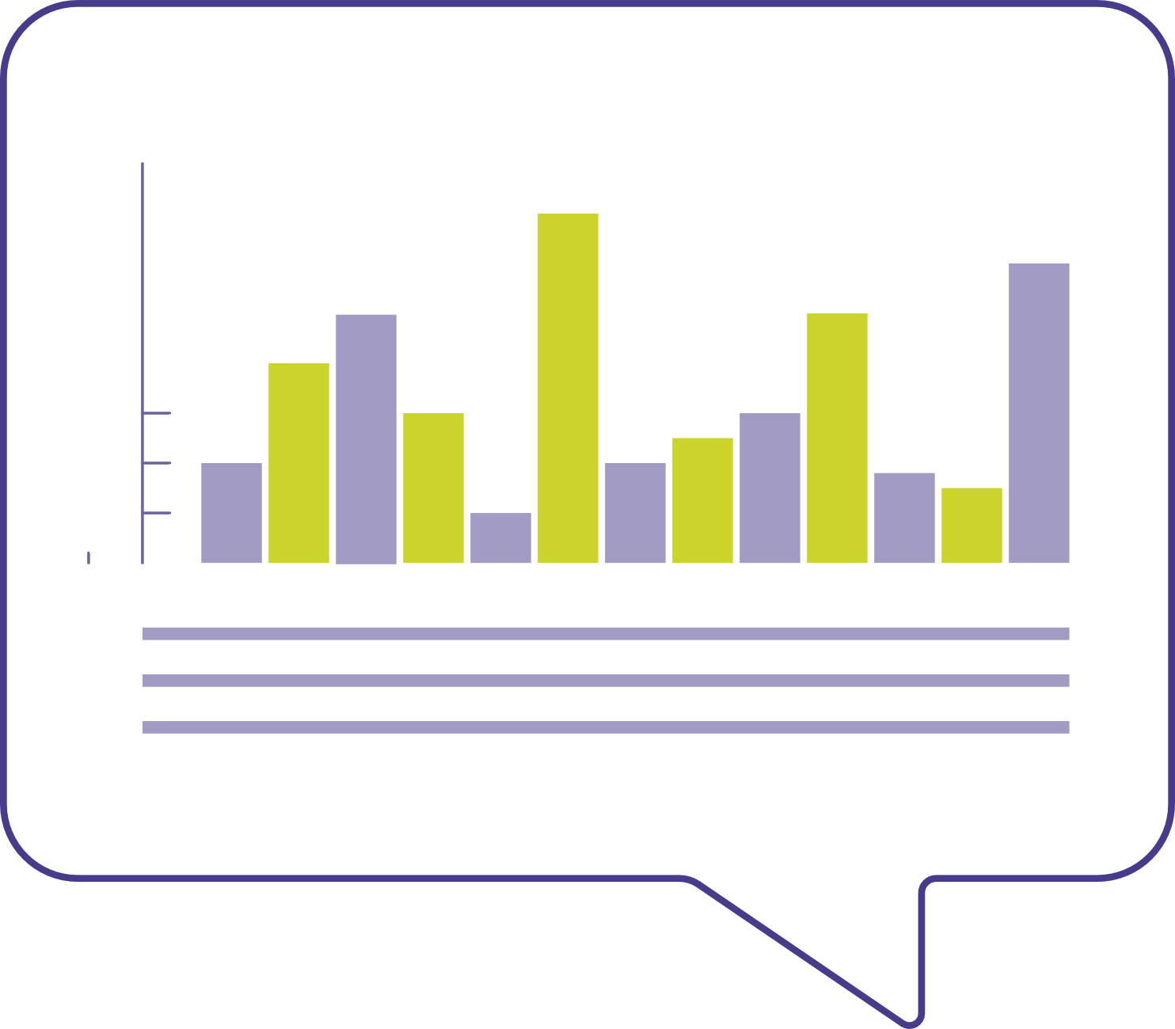


Comprehensive and proactive programme of
communications and engagement in place

Slide 28






Changing the way we
engage with the market
We are meeting with:
Largest schemes
Third party administrators
Administration software providers
Trustee companies
Legal firms
Dashboard integrated service providers

Slide 29




Writing directly to the
Chair of trustees
and scheme
managers

Slide 30
To date
OVER 1,000
OVER 1,000
schemes have been issued
with our first communication
OVER 1000

Slide 31
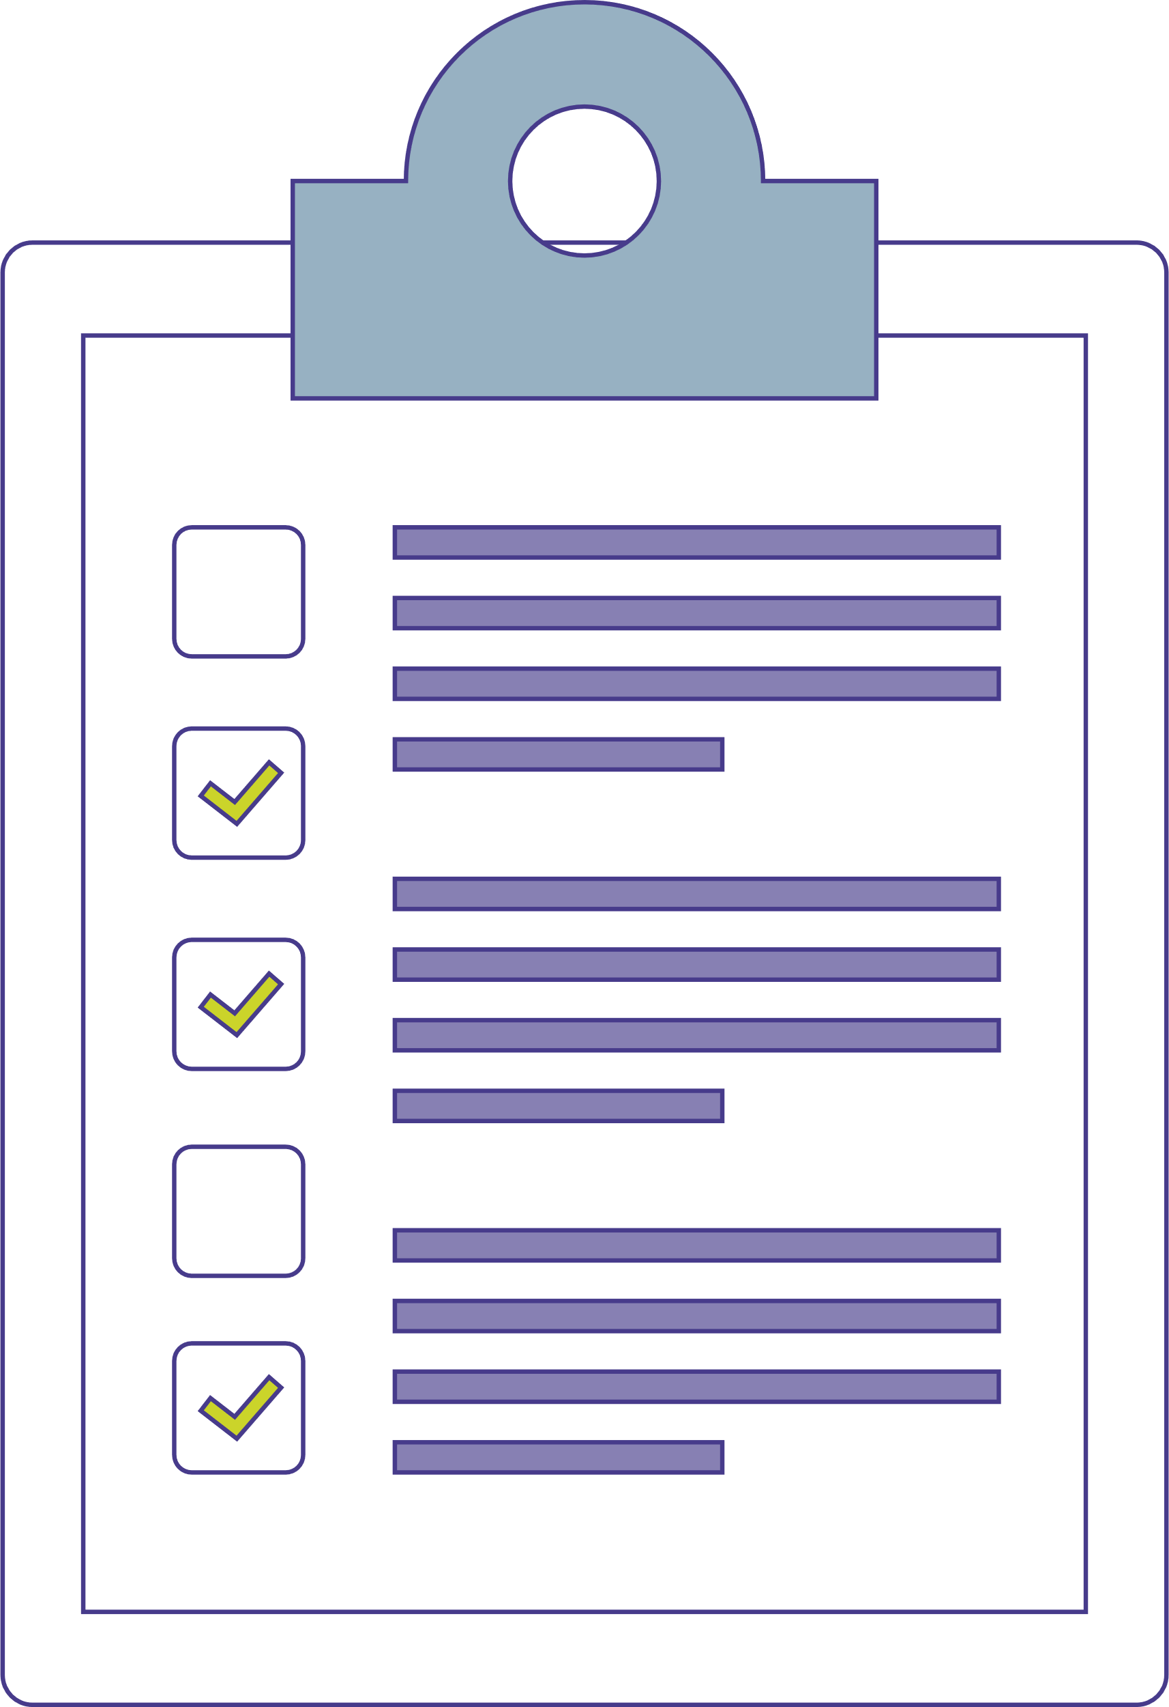

Sending out surveys to all schemes at key points in their connection journey

Slide 32
Published our
Compliance and enforcement policy
and updated our
breach of law guidance

Slide 33
Guidance and useful information is on our website
Dashboards checklist is also available to download

Slide 34

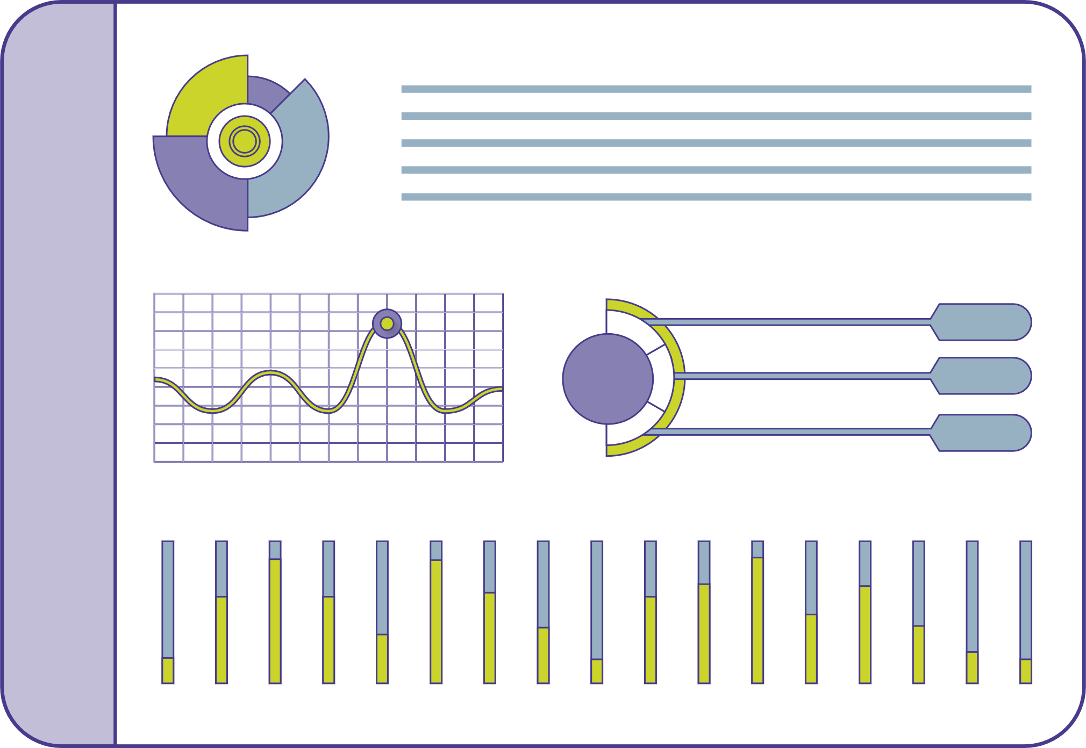
Preparing to comply with dashboard duties
for both trustee and service providers who support trustees

Slide 35
Q1. Can you tell me a little bit about your background and how you got started as a professional trustee?
“In terms of my background, I’ve spent my whole career in the pensions industry, including the last 4.5 years as a professional trustee and before that, nearly 20 years as an actuary.”
“I currently sit on the boards of a number of DB and DC schemes, which range from very large to very small. I’ve supported schemes across a range of projects, including buy-ins and buyouts, transfer of DC to Master Trust, GMP projects and of course, pensions dashboards!”

Slide 36
Preparation for dashboard duties

Slide 37
Q2. What’s your experience on data preparation work that your schemes conducted additionally for dashboards? What are the biggest challenges that you’ve faced in this area?
“The wider context here is that while data for DC schemes has always needed to be clean on an ongoing basis, for DB schemes historically there was a view that, typically, the data only needed to be clean when benefits were crystallised. There has been a much broader shift to improving DB data in the industry over the past 5 to10 years — to support GMP projects, insurance transactions, administration self-service, in addition to dashboards.
And it’s worth thinking about this broader view when considering data projects, to consider the data cleaning actions that might be needed across different projects and how these might be combined for efficiency or prioritised where needed
In my experience, at the current time all schemes are doing data work, but different schemes are in widely different positions on the cleanliness of their data. And this is usually for scheme specific reasons, for example, more complex benefit structures or more changes in the administrator.”
cont…

Slide 38
“Thinking about dashboard specifics:
One aspect where dashboards is perhaps changing the dynamic is in relation to data items that erode in value over time, such as postcodes which may feature in FIND data, as it’s created a greater reason to seek to improve these ahead of members approaching retirement.
Moving onto value data, on the DB side, administrators have generally been increasing automation over time, which is now really helpful from a dashboards perspective. However, there may be calculations which haven’t yet been automated – for example, there might only be a small number of members with a particular benefit structure, which was fine if dealing with a drip feed of these members retiring, but the 10 day turnaround for dashboards might mean that it’s now worth considering automating these calculations.
And, it’s worth noting that the specialist teams within administrators who typically undertake the programming of benefit calculations are really busy at the moment, so it’s worth considering values and the degree of automation in your scheme sooner rather than later.
And if you haven’t yet got your teeth into the specifics of value data, and in my experience lots of schemes haven’t reached that point yet, while FIND data is often quite standardised across schemes, the value data considerations are more scheme specific... So don’t underestimate what’s required at this stage!”

Slide 39
Q3. In your experience with data cleaning, how do you work with administrators to establish and maintain the process, to ensure member data remains accurate and complete?
“Yes, I’m seeing an increased focus not only on whether the data is there, but also whether what’s held on the admin systems is right.
For example, dashboard readiness reporting from your administrator might include a review of items that can be used for matching with FIND requests, including an accuracy assessment (which might be based on using external financial reference data ) and an assessment of the percentage of likely matches based on matching policy recommendations.
We’ve seen some value in engaging with the actuaries too, to help sense check approaches taken by admin teams and ensure we’re not either over-simplifying or over-complicating matters. This is useful where a dashboards team may not be the business as usual (BAU) team and/or the capacity constraints on the BAU team could otherwise cause potential issues. It’s an additional knowledgeable resource to help provide assurance to the trustees and to help reduce bottlenecks in service.
On a related point, we’re also seeing schemes thinking about member communications as part of the coding that goes alongside the value data, or more generally as part of wider scheme communications.”

Slide 40
Q4.“Could you share your experience on how you ensure that administrators, and other relevant providers, are on track with their progress? What steps do you take to ensure that your administrators bring forward relevant information at the right time for you to make a decision? Specifically, how do you ensure you have sufficient and reliable information to make well-informed decisions?
“Yes, while schemes in my experience, are relying heavily on their administrators to manage process, trustees still retain the ultimate responsibility, and it’s worth remembering that there are legal deadlines to meet.
You should have received project plans which you can review and monitor progress against to ensure your scheme will be ready by its staging date. As a reminder, I’d expect all trustee boards to be discussing dashboards on a regular basis.
I’d also recommend using the TPR checklist on an ongoing basis to tick off the items as you go. PASA has also produced lots of useful guidance covering matching, value data and connection readiness and there’s also the recently published ‘dashboard toolkit’ to support trustees and administrators in connecting AVCs to dashboards – all really useful resources to check out if you haven’t already.
cont…

Slide 41
“In my experience schemes with Summer 2025 staging dates typically have their FIND data agreed and are in various stages of working through value data. From about-to-start to almost complete on the scheme specifics of this. In some instances, data progress has been delayed due to challenges with agreeing the contractual side with administrators which can impact timelines, but arguably, ensures a higher standard of accountability.
A few other observations on the impact of dashboards on the admin market are:
- in some cases, dashboards had prompted schemes to move to third-party admin
- in other cases, dashboards is creating a barrier for schemes to review administrators at the current time, as schemes are reluctant to potentially change administrator as we approach dashboard deadlines; it’s possible there may be some delayed administration retenders once dashboards have settled in
- some schemes are looking to consolidate AVC providers to reduce dashboard issue
If you have a small scheme without a third-party administrator or on a non-standard admin platform, there are some solutions out there for dashboards, but I’d suggest engaging early to ensure you can contract with an ISP provider and comply.
It’s also worth making sure your governance is lined up in advance. Some schemes have set up dedicated working groups, and some are delegating to an admin or benefits committee. If so, it’s worth updating the terms of reference to ensure the appropriate delegations are in place to take the relevant decisions, at the appropriate time.”

Slide 42
Trustee
responsibilities:
Record-keeping

Slide 43
Q5. Are there common practices or specific record-keeping considerations that a trustee should be mindful of, in relation to dashboard preparations?
“Record keeping is a broad topic.
In relation to dashboard preparation, and the decisions currently being taken, in my experience, these discussions are typically taking place in minuted meetings, so there is typically a good audit trail in place. There are often helpful summary papers being prepared by administrators to cover the agreed decisions, for example, in relation to find data and value data.
As I mentioned previously, TPR’s checklist is helpful in terms of various other aspects of the project that you need to consider and would therefore be wise to have documented through the process.
I’d also suggest the recent enforcement policy shared by TPR has some useful examples, such as in relation to schemes winding up before Oct 26 and what schemes might want to consider and document in these circumstances.
And it’s always easier to create an audit trail as you go, than create one later in the process, so do think about it as you go along. More generally, on any data work being undertaken, I always strongly suggest ensuring the teams doing the data work are creating a strong audit trail as part of that job.
Down the line, trustees will want to think about what records are held in relation to data created and shared on dashboards. It’ll also be worth thinking about the impact on data mapping and there’s an impact on the Data Protection Impact assessment (which you’ll pick up if you’re working through the TPR checklist).”

Slide 44
Q6. Have you seen any opportunities or benefits that have emerged from this preparation work?
Yes, it’s very easy to think of the challenges at this stage especially!
But there are also lots of benefits that dashboards could bring such as:
Increased member engagement in pensions – we know this can be a big challenge, especially in DC, and is more generally another way for your members (who you may have lost touch with) to initiate contact with your scheme or action from members
Encouraging members to consolidate DC pots
And encourage schemes to potentially streamline historic AVCs
Improved data
Increased automation
These all support more self-service administration

Slide 45
OVERVIEW
OVERVIEW
OVERVIEW
Opportunity for savers to be able to
access their pensions

Slide 46

You will play a vital part in making this happen:
Connecting to the dashboard ecosystem
Find members and providing them with accurate information
Once connected, the remaining legal duties kick in

Slide 47
Ensure compliance with the requirements
We have recently published our compliance and enforcement policy

Slide 48



Our policy sets out expectations on schemes
to be able to demonstrate how they’ve had regard to the DWP’s connection guidance

Slide 49



Committed to taking
a pragmatic approach
to compliance
and will focus on saver outcomes

Slide 50
We recognise that some requirements may be challenging for industry to meet

Slide 51
Our compliance and enforcement policy is principles-based

Slide 52
Overview of the principles
Focused
on outcomes for savers
Pensions dashboards is a huge challenge for industry
Risk-based and proportionate
Focus on the quality of the data held by schemes
Focus on the governance
of schemes
Schemes will be highly dependent on third parties

Slide 53
Scheme failing to connect by the connection deadline
We highlight a number of key risk areas
Being unable to demonstrate how they’ve had regard to the DWP’s guidance on connection
that we will focus on in the policy
Data quality and data controls

Slide 54
Guidance to be taken into consideration
We have set out our expectations towards compliance
Schemes should have systems of governance and internal controls:
Record-keeping
Risk management systems
Controls when selecting, appointing and managing providers
Processes in place to identify
and report breaches of law

Slide 55
Our policy sets out how we will monitor instances of non-compliance and our approach to breaches

Slide 56
Schemes should also maintain their own records, as per regulations

Slide 57
  We will use this data to identify breaches, as well as looking at trends to see where an issue may warrant further investigation.
  We may request additional information from schemes where we identify concerns or where we are looking to identify best practice. This includes gathering information on a number of schemes on a thematic basis, for example through a thematic review.
  Existing duties around breach of law reports continue to apply, and schemes should follow the reporting expectations as set out in our code of practice. We have recently updated this guidance with dashboards-specific examples, to demonstrate our potential approach to Breach of Law reports using a red, amber and green system. For example, we would consider failure to connect by the deadline of the 31st of October 2026 to be a “red” breach and must be reported to us.
  Where there has been a breach or suspected breach of legislation, we will consider if an investigation is appropriate and, if necessary, take regulatory action (including enforcement). We have discretion over our approach in respect of action on compliance with dashboard regulations and we will consider, on balance, any action we may take against the outcomes we may achieve.
  We have powers in relation to non-compliance with dashboard duties, including compliance-notices, penalty notices and options in relation to third parties, where they have caused a trustee or scheme manager to be in breach of their duties.
  As I have mentioned previously, we will be prudent with the use of our powers, but in the event of wilful or reckless behaviour we will be robust in our approach.

Slide 58
SCENARIO
SCENARIO
SCENARIO
Demonstrate how
everything may work in practice

Slide 59
Failing to match
savers to their pensions
Scheme E and F who do not return any possible matches to their find requests

Slide 60
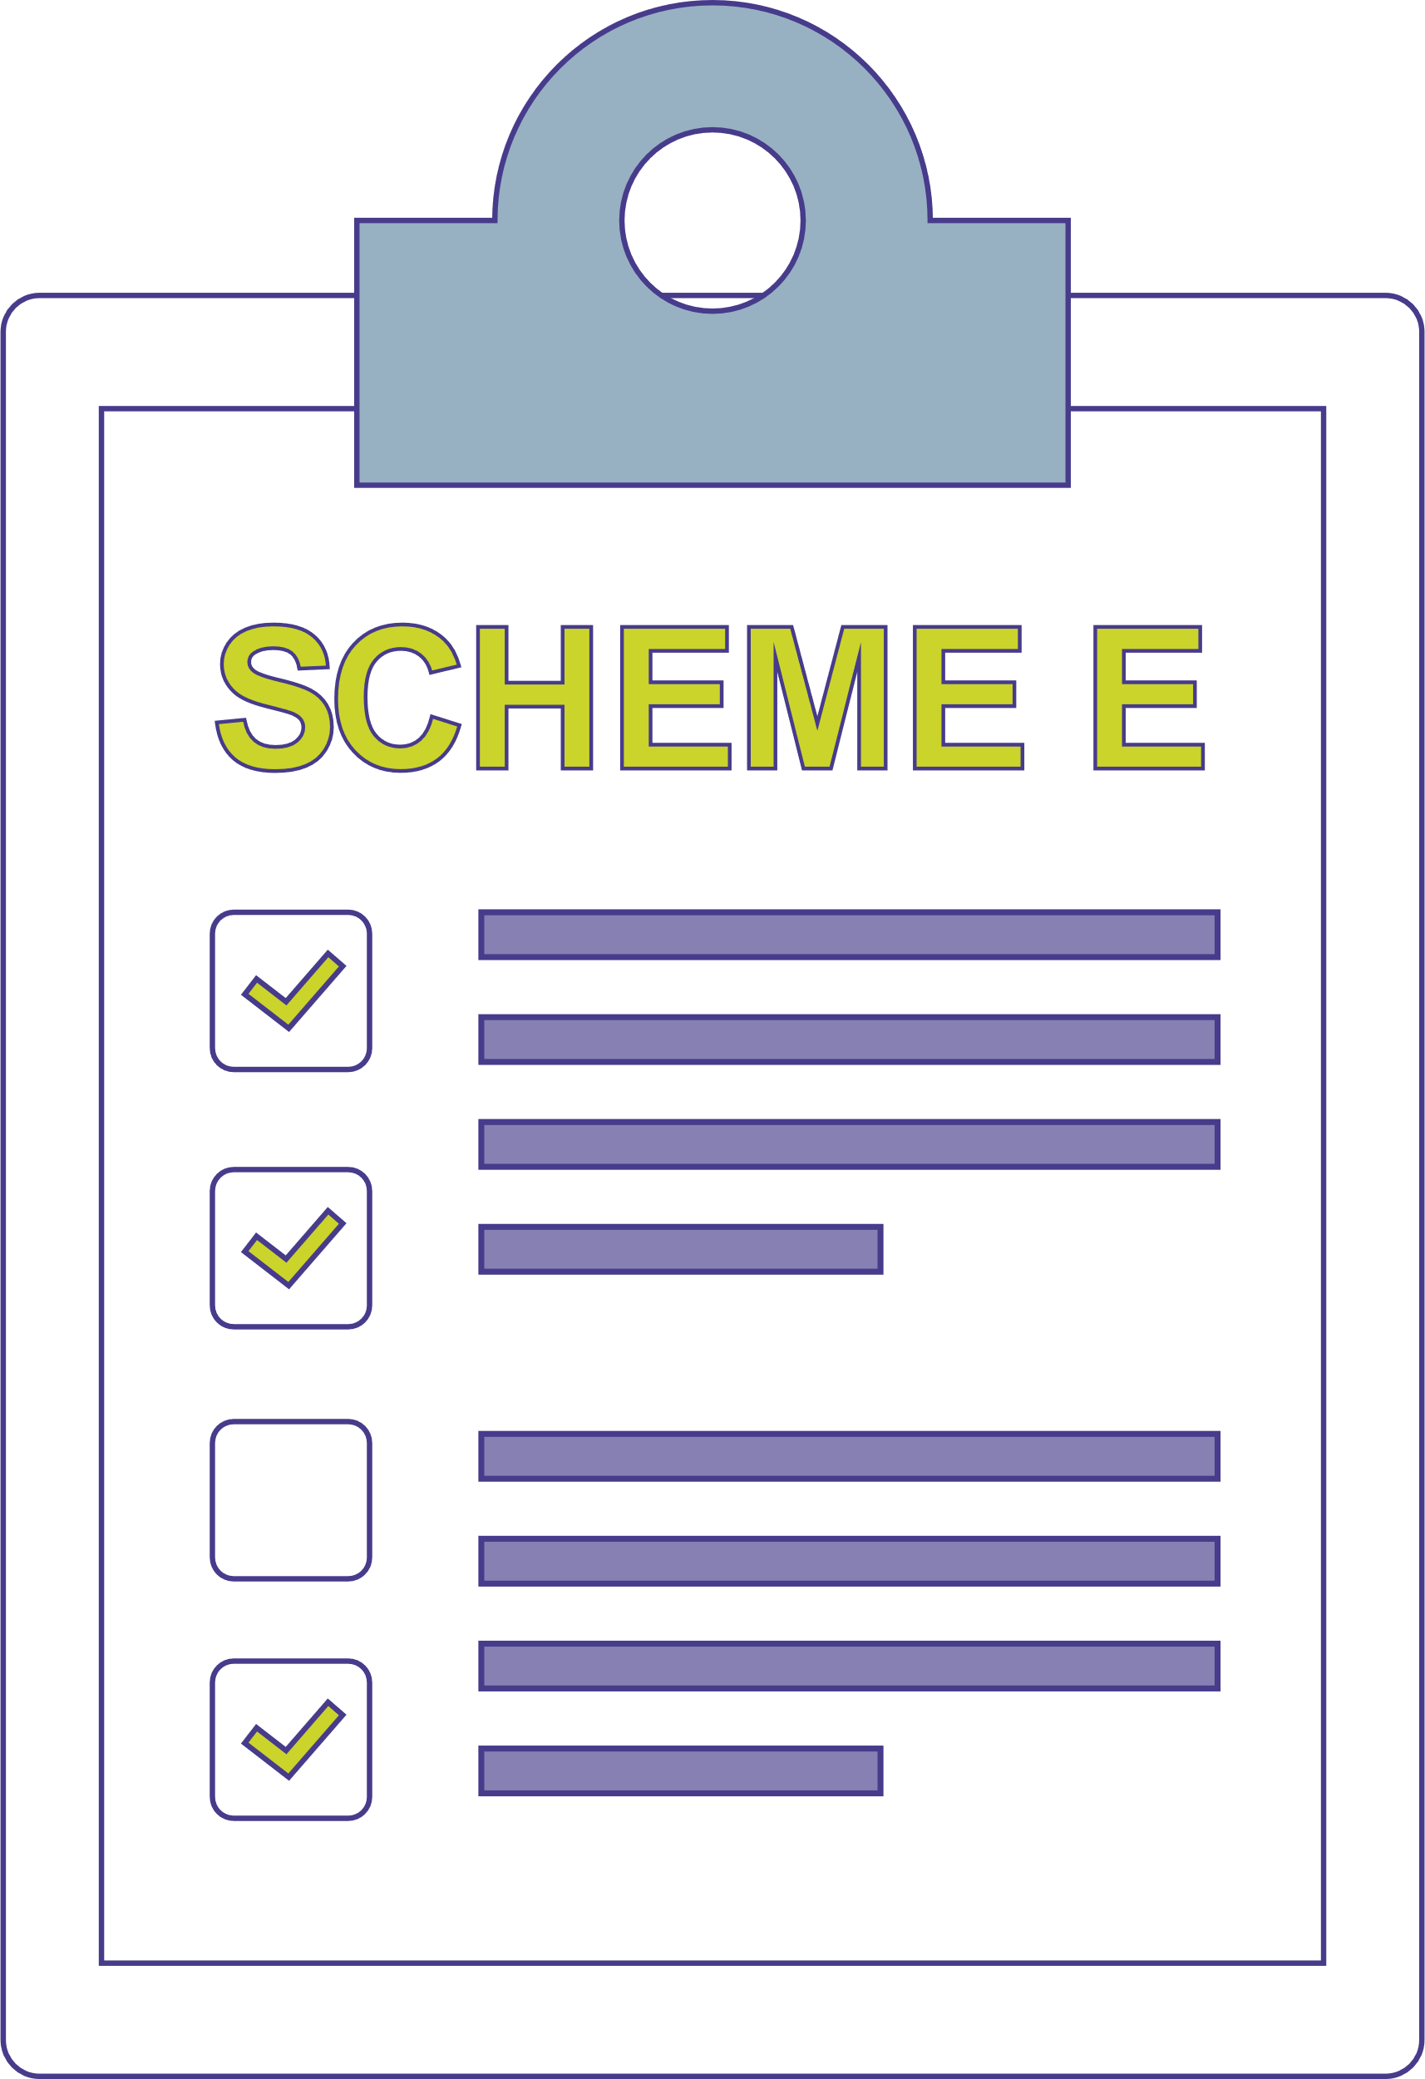
Pension dashboards are still in user testing
Scheme E sets a tight matching policy
Action
We issue a third-party compliance notice to the employer to provide the data set out in their legal obligations

Slide 61
While pensions dashboards are still in user testing, scheme E sets a tight matching policy, as their administrator advised they would be unable to handle the volume of queries arising from ‘possible matches’ due to limited resource.
This is caused by large data gaps in members’ first names and National Insurance numbers. The administrator has already put in place an improvement plan for these data gaps, but one large employer has not been providing the information they need, despite repeated attempts to engage.
As not matching savers is a breach, the trustees reported this breach to us. Upon investigation, the employer is unable to provide a reasonable explanation for this to us.
  Action: We issue a third-party compliance notice to the employer to provide the data set out in their legal obligations, which is needed by the scheme. We follow up with the trustees of scheme E to ensure that the matching policy is reviewed once the issue is resolved and monitor the volumes of possible matches to confirm.

Slide 62
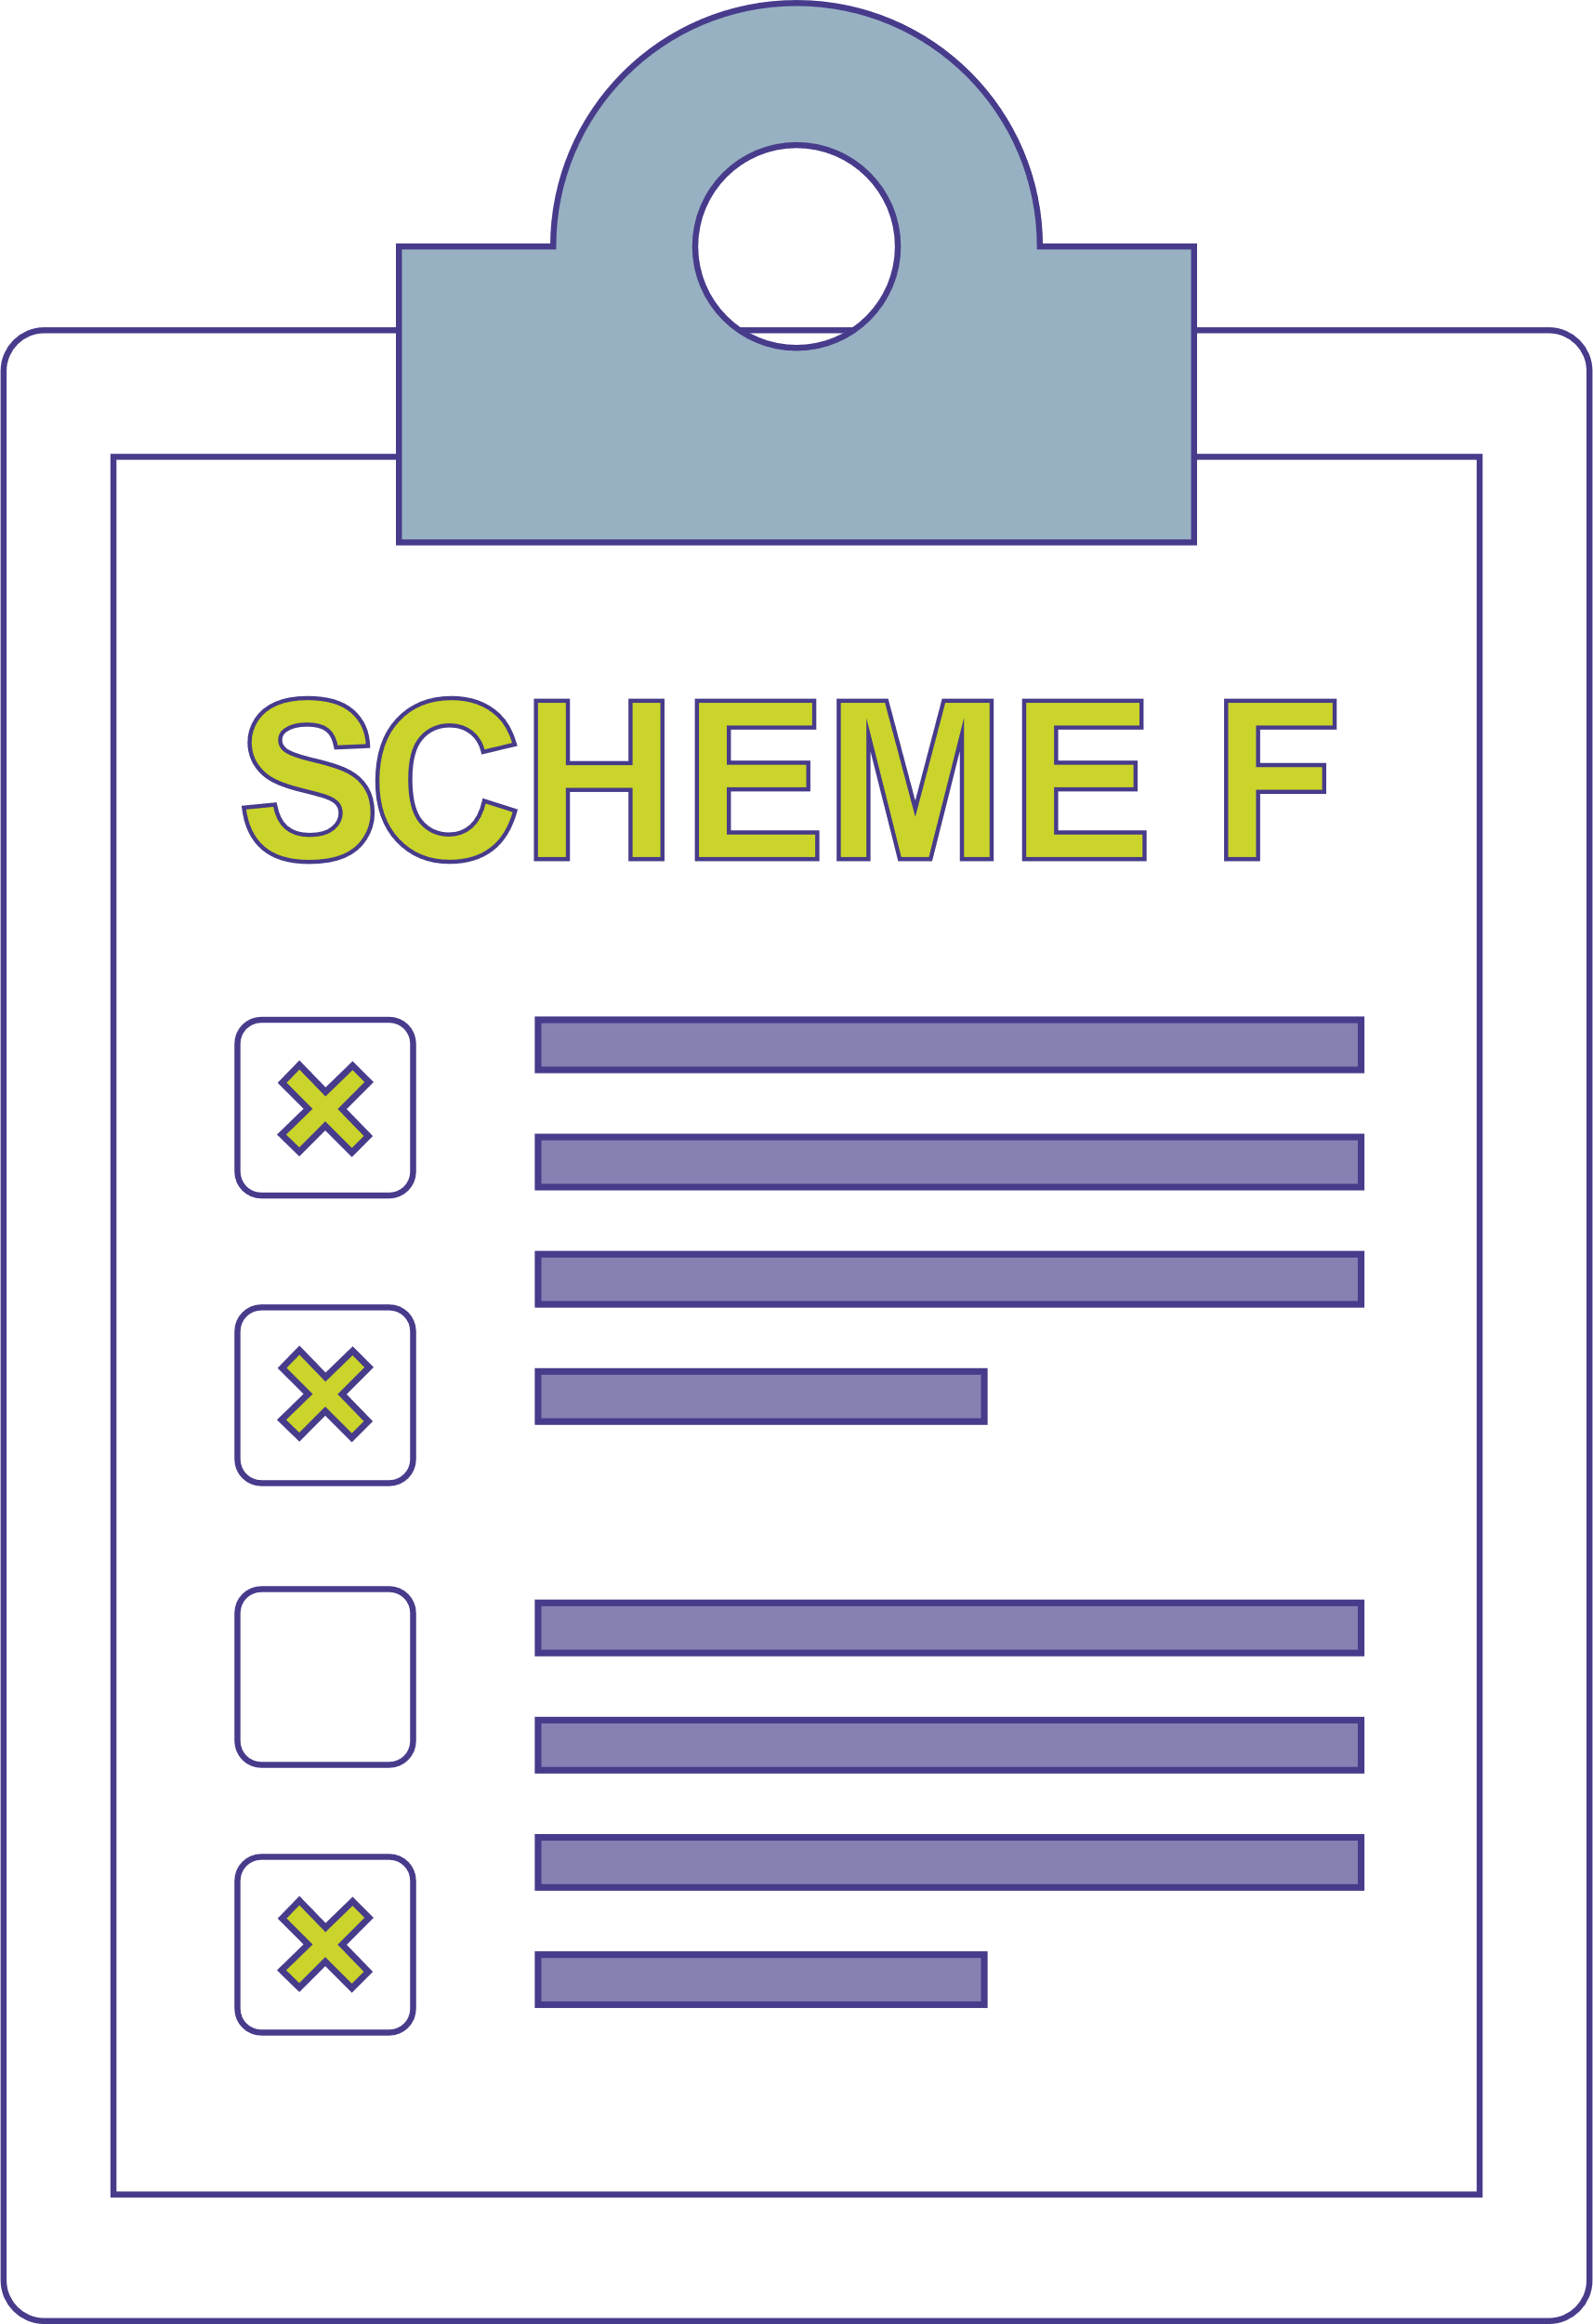
Trend analysis of the system data over several months after public launch
Scheme F hasn’t returned any possible
matches
Action
Not matching savers is a breach, we issue a compliance notice for the scheme to review its matching policy

Slide 63
Trend analysis of the system data over several months after public launch identifies that scheme F does not seem to have returned any possible matches.
We investigate and confirm that the scheme is using a binary matching policy, which does not allow for possible matches – only full matches. The trustees are unable to provide any explanation as to why they are only allowing for full matches.
  Action: As not matching savers is a breach, and their binary matching policy might be causing this to happen, we issue scheme F with a compliance notice for the scheme to review its matching policy to ensure it is appropriate

Slide 64

Comprehensive programme of
industry engagement
where we meet with a wide variety of stakeholders

Slide 65
Multiple administrators and AVCs
Discussions with and about schemes with multiple sections and administrators
Legislative perspective
Third-party administrator perspective
Some schemes having difficulties engaging with AVC providers

Slide 66
Since the publication of DWP’s guidance on connection, there have been discussions with and about schemes who have multiple sections with multiple administrators. So where do the main challenges lie?
From a legislative perspective, all parts of the scheme must connect at the same time, even if administered by different providers. This means that trustees need to ensure they’re communicating with all those involved to understand how each part of their scheme will connect to dashboards (there is no single solution), which members are in scope to be connected, and to ensure that the quality of data enables the right information to be returned to the right person. Don’t assume your administrators are dealing with this for you – the decisions lie with you, the trustees.
From a third-party administrator perspective, it may not beknown that there are multiple sections within a scheme, administered elsewhere, and this can lead to incorrect assumptions by administrators on what a scheme’s connect by date is. In fact, there could be a risk that an administrator may not know that the section of a scheme that they administer is even in scope for dashboards. This may also apply to your AVC provider. This just reiterates it is so important to start those dashboards conversations early.
We are also hearing that some schemes are having difficulties engaging with providers – particularly some of the AVC providers. What’s important is to keep communicating, and ensure you have robust governance and audit trails in place so that you are able to clearly demonstrate the actions that you have taken.

Slide 67
Buy outs and schemes in scope

Slide 68
Buy-outs are a common theme that we are hearing. More schemes are thinking about derisking, so may be wondering – why bother with dashboards?. Well, you should bother, the data improvements you need to make for dashboards are also the kind of improvements you need to make for derisking, so they may help you get a better deal. And not everyone who hopes to buy-out before 31st October 2026 will buy-out, and then you, as trustees, will be responsible for not complying​. Considerations need to be made about the limited capacity in the market, unless a scheme is already working with a buy-out provider, it’s risky to assume the transaction will be completed in time. ​
Schemes only fall out of scope of the dashboards regulations when the number of relevant members falls to zero. This means that, unless all members in the scheme are pensioners, or the buy-out has completed for all relevant members, the scheme will remain in scope for dashboards.

Slide 69
Change of administrator
How does the
legislation apply?

Slide 70
Change of administrator is also a very common topic in terms of how the legislation applies. The legislation is clear – once a scheme is connected, they must stay connected, in line with the PDP’s standards. When there is a change of administrator there will not be a ‘black out’ period for dashboards connection and trustees remain required to meet their dashboards duties and stay connected while the change takes place.
Trustees and scheme managers must consider dashboards duties when onboarding a new administrator.
They should maintain a robust audit trail, which includes the planning process and any risk management measures put in place for the change of administrator.

Slide 71
Increased engagement from members

Slide 72
Dashboards will increase member engagement and there are concerns – from schemes and from administrators – centred around the impact that dashboards will have on traffic to call centres, in an industry where administration resources are already under pressure.
Another topic that is commonly raised is what the DWP communications campaign look like before the dashboards are launched to the public, and when will schemes have more information so they can understand and plan? While the focus right now is, rightfully, on getting schemes connected, this is an active conversation with delivery partners and more information will be shared on this in the future.

Slide 73
Q&A

Slide 74

It’s all for the ultimate goal
of improving saver outcomes

Slide 75
THANK YOU
THANK YOU
THANK YOU
THANK YOU

